Slide 1
Data Analysis and Prediction
RuralAI Sensor kits

Slide 2
What we want to do?
Collect data from sensor stations
Use HFL to predict future values for decision making
Things to consider
Data quality, frequency, missing value etc.
No HFL framework to work with

Slide 3
Data
Soil Humidity
Quality: zero values and peaks, noisy values, missing values
Quantity: small dataset 1000-3000 samples, not enough datasets for FL
Preparation: feature engineering, split, scaling

Slide 4
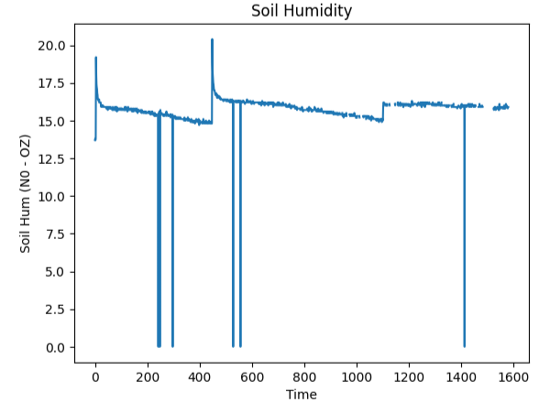
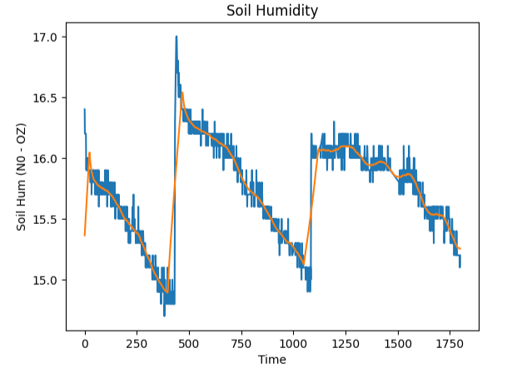
Data Quality
Zero values and Peaks when Watered -> Suppress them + interpolation.
2. Noisy Values -> Use a rolling average method to smooth them
3. Missing values -> Interpolation

Slide 5
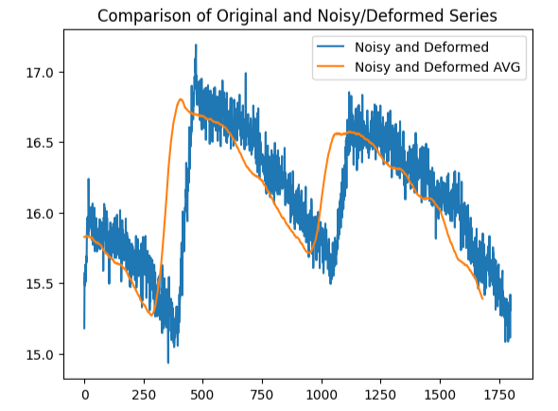
Data Quantity
Small Datasets - > Difficult to do much about it, but around 2000 samples is the minimum required for training a deep learning neural network
Not enough datasets -> Inspired by computer vision : data augmentation : used a ‘good’ dataset, add noises and distortion = new dataset

Slide 6
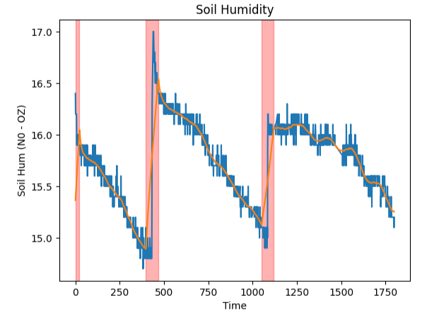
Data Preparation
Feature engineering
Add a Watered feature that detected when the crop is watered (1) and when it is not (0) using differentiation.

Slide 7
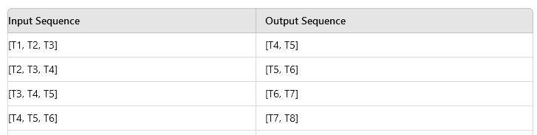
Data Preparation
Time series analysis with LSTM
We needed n_step_in (the number of sample we give our model) and n_step_out (the goal is a 5h prediction and data is 10 min sample => n_step_out = 30))
Example with n_step_in = 3, n_step_out = 2
MinMaxScaler() : for faster convergence (fit_transform on train and transform for val and test)

Slide 8
Data Preparation
Splitting 1/2 :
Time series (T1, T2,…TN-1, TN)
Train (75%)
Validation (15%)
Test (15%)

Slide 9
Data Preparation
Splitting 2/2 : (example with train set but similar with the other 2)
Step 1/n
n_step_in
n_step_out
Train
X1 = (T₁, T₂,… T_{n_step_in})
Y1 = T_{n_step_in + 1},… T_{n_step_in + 1+ n_step_out}
X_train | Y_train
X1 | Y1

Slide 10
Data Preparation
Splitting 2/2 : (example with train set but similar with the other 2)
Step 2/n
n_step_in
n_step_out
Train
X2 = (T₂, T₃,… T_{n_step_in + 1})
Y2 = (T_{n_step_in + 2},… T_{n_step_in + 1+ n_step_out + 1})
X_train | Y_train
X1 | Y1
X2 | Y2

Slide 11
Data Preparation
Splitting 2/2 : (example with train set but similar with the other 2)
Step n/n
n_steps_in
n_steps_out
Train
Xn
Yn
X_train | Y_train
X1 | X2
…. | ….
Xn | Yn

Slide 12
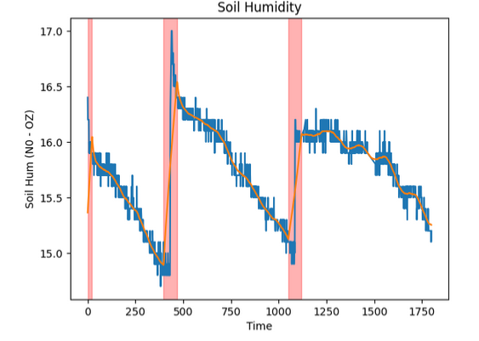
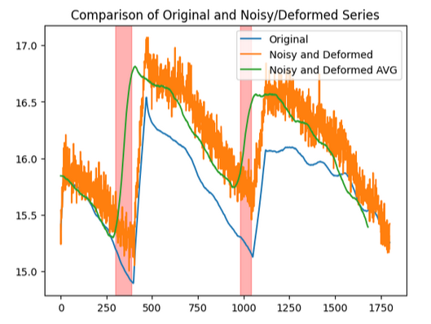
Data Overview
Client 0 : N0OZ (06/06 -> 24/06) / 1800 rows
Client 1 : N0OZ modified (15/07 -> 07/08) / 2900 rows

Slide 13
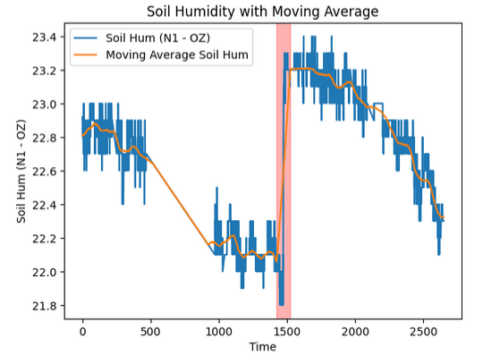
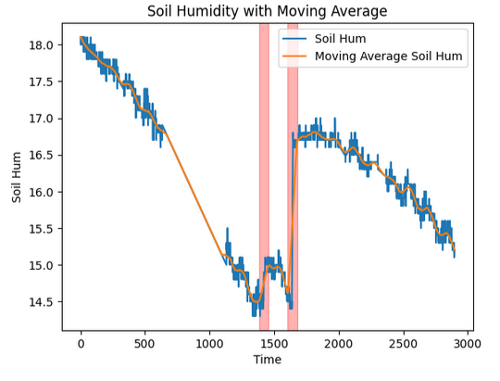
Data Overview
Client 2 : N1OZ (15/07 -> 07/08) / 2650 rows
Client 3 : N0OZ (15/07 -> 07/08) / 2900 rows

Slide 14
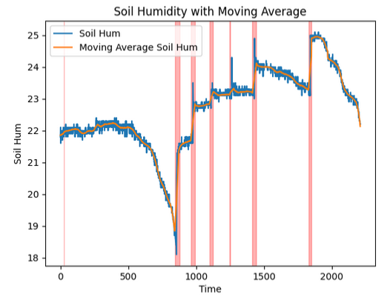
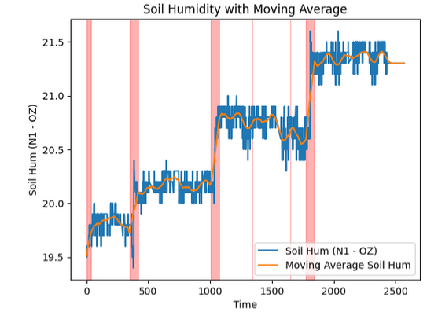
Data Overview (other possibilities)
N3NZ (02/07 -> 15/07) / 2211 rows
N1OZ (06/06 -> 24/06) / 2571 rows

Slide 15
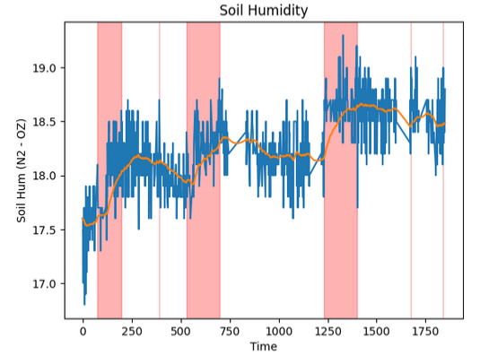
Data Overview (other possibilities)
N2OZ (06/06 -> 24/06) / 1850 rows

Slide 16
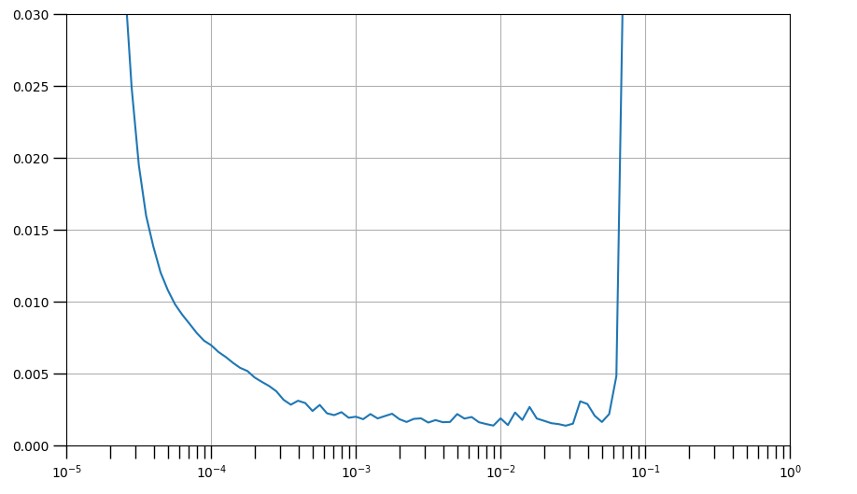
Local model
Architecture / Hyperparameters :
Fix :
Batch_size = 64
Learning rate = 5e-3
Optimizer = Adam
Loss = MSE
n_step_out = 30
Variable :
n_step_in / num_layers / num_units
Learning rate finder
5e-3

Slide 17
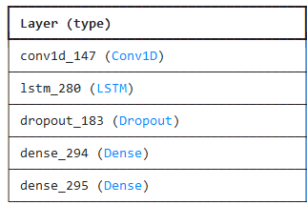
Local model
n_step_in
Architecture
1 layer
n_step_out
Inspiration : https://github.com/https-deeplearning-ai/tensorflow-1-public/blob/main/C4/W4/ungraded_labs/C4_W4_Lab_3_Sunspots_CNN_RNN_DNN.ipynb

Slide 18
Local model
Stopping criteria –adaptive
ReduceLROnPlateau : smart reducing of learning rate while training.
EarlyStopping : stop the training if the loss on the validation set goes up (to avoir overfitting) and restore the best model

Slide 19
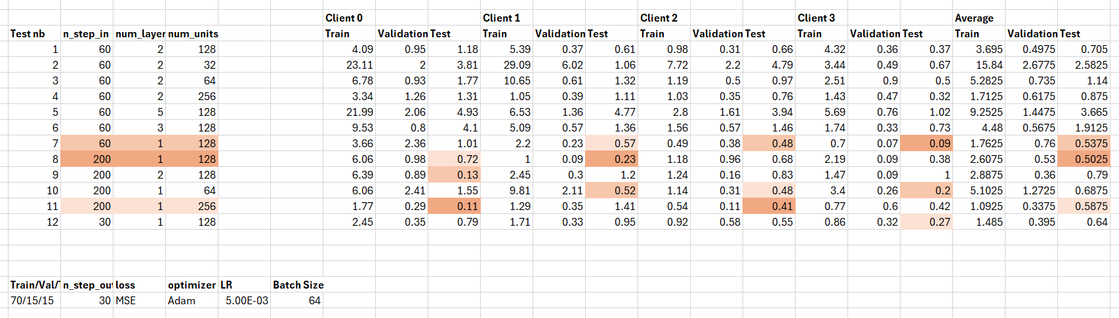
Local model
3 best models
Nb | n_step_in | num_layers | num_units | Test loss AVG
1 | 200 | 1 | 128 | 0.50
2 | 60 | 1 | 128 | 0.53
3 | 200 | 1 | 256 | 0.59

Slide 20
FL
1rst scenario: 4 clients, 2 local servers (2 clients in each) independent
Local Server 1 (LS1)
Local Server 2 (LS2)
Client 0
Client 1
Client 2
Client 3

Slide 21
HFL
Flower does not support HFL - > Recode some parts to work with HFL
Started with simple scenario:
4 clients, 2 local servers (2 client in each)
and one global server
Global Server
Local Server 1
Local Server 2
Client 0
Client 1
Client 2
Client 3

Slide 22
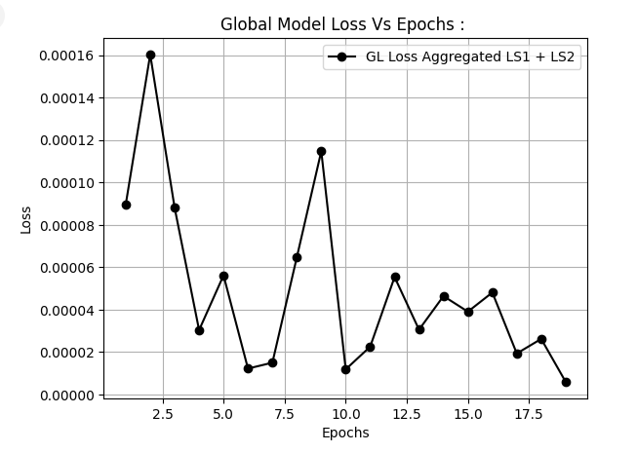
Results
Losses for all models for every client data
! Google collab limitation

Slide 23
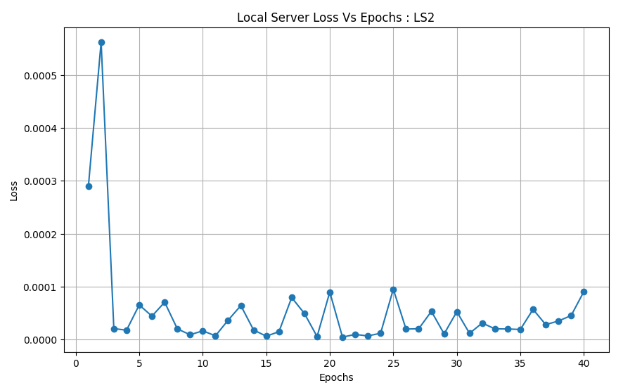
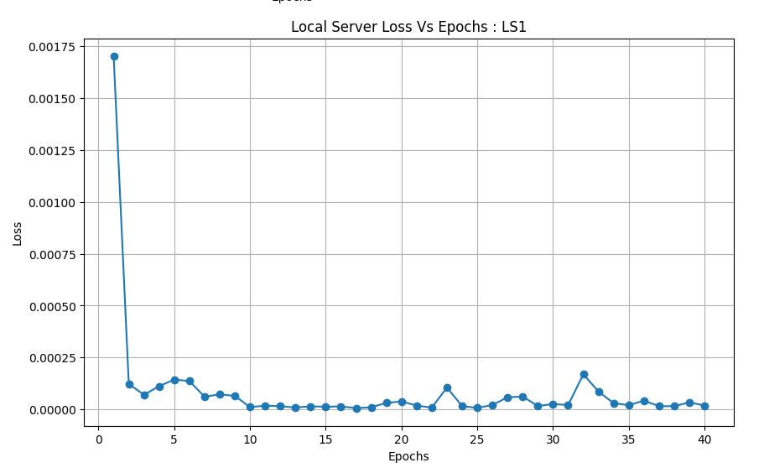
Results

Slide 24
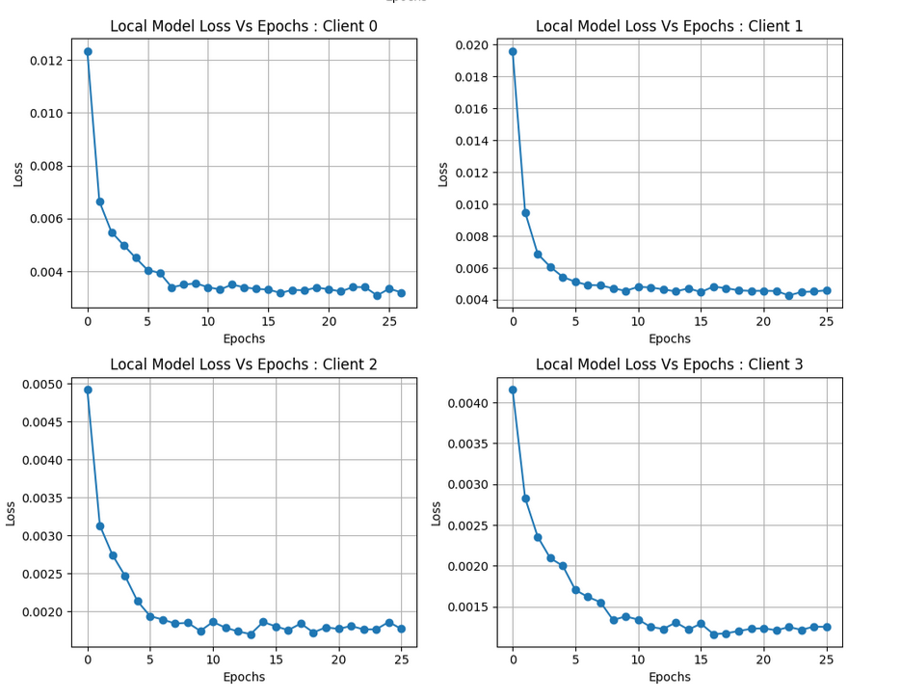
Results

Slide 25
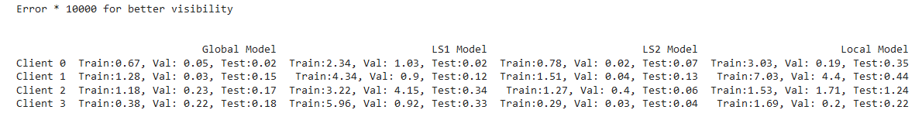
Results
Bar graph for comparing loss (mse) for local client, local server and global server

Slide 26
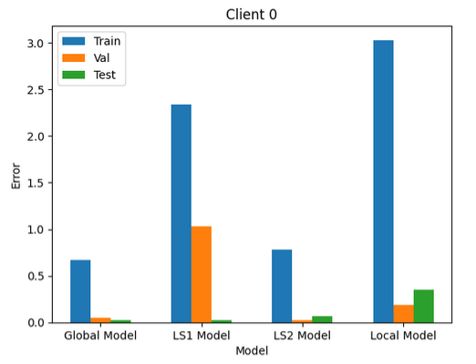
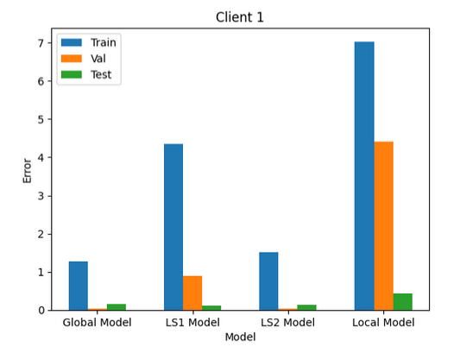
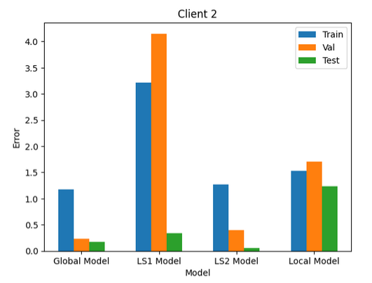
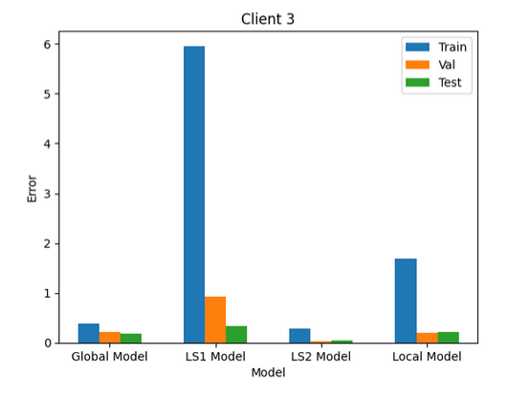
Results
Observations and Hypothesis:
Train error > Val error: early stopping on validation loss
Train error > Test error : test set always decreasing but train set has increasing parts

Slide 27
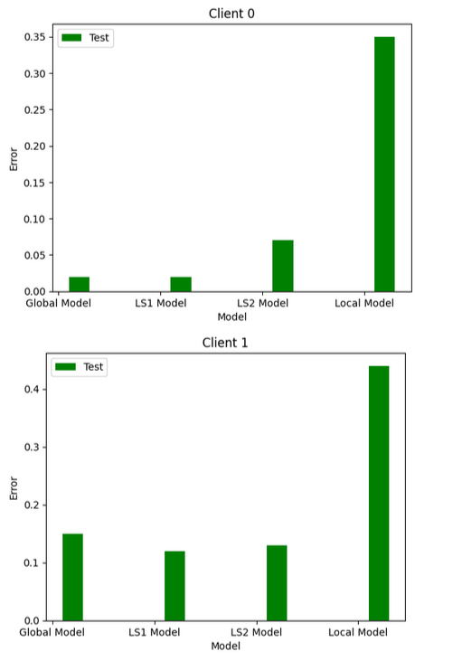
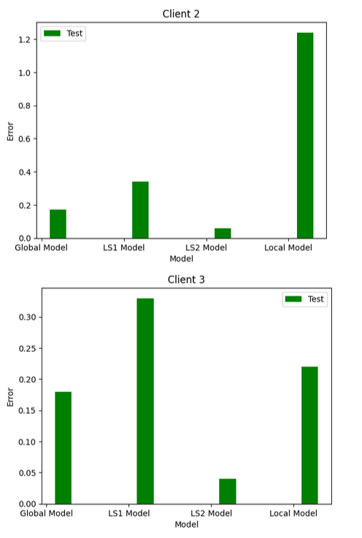
Results
Observations and Hypothesis:
Local Model Error > Global Model Error:
Not enough data when local training
Local server model error lower with corresponding client : (as it should be)

Slide 28
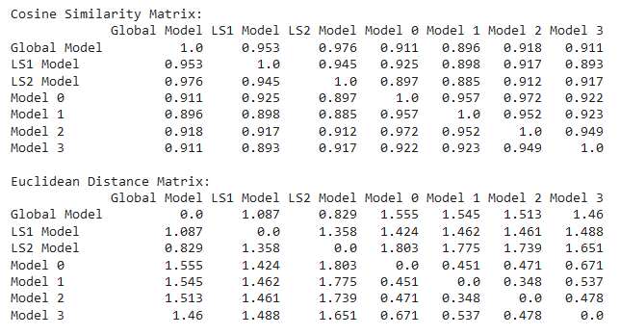
Results
Compare similarity index and model performance :
Cosine / Euclidean : between parameters from models

Slide 29
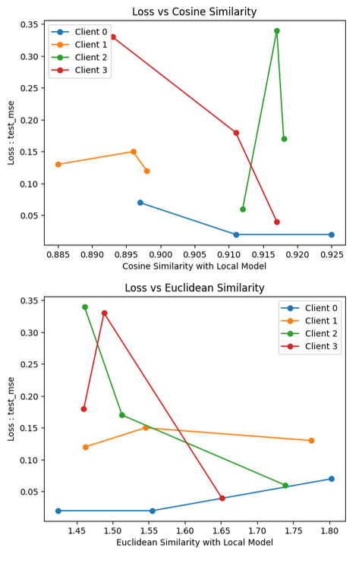
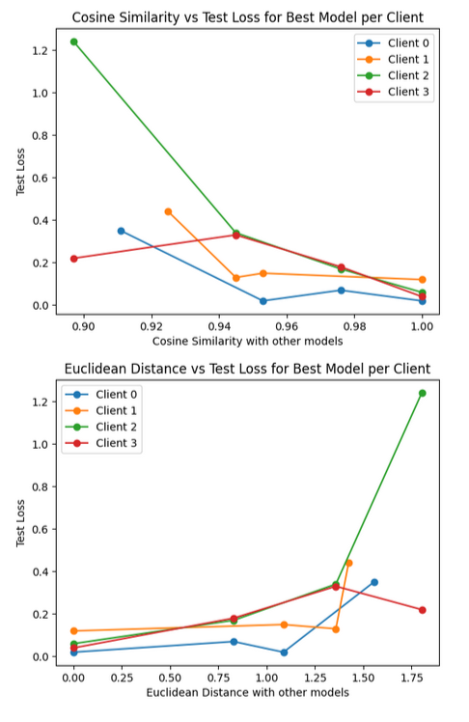
Results
Local Model as Basis
Best Model as Basis

Slide 30
Next Steps ?
Try with satellite signal data
Find a way to make Global Server model converge

